Slide 1

An Urban Morphogenetic Analysis of Geospatial Water Scarcity in South Africa
Conall Templeman | December 2024 | Gateway 1

Slide 2

Project Exploration
Morphogenetic programming and regenerative architecture
Regenerative biomaterials and green urban design
Crowd dynamics through agent-based modelling
Cellular automata and urban morphology

Slide 3

Project Summary
Build relationships between existing urban morphology, population and water scarcity
Model urban growth patterns for Cape Town using cellular automata, distinguishing between dense city centres and fringe settlements
Build predictive models to show how the problems will continue to worsen (expectedly worse in fringe settlements)
Demonstrate the potential impact of design

Slide 4
Cape Town
Started by looking at Sub Saharan Africa, since most urban growth is said to occur there
Focussed on South Africa with a particular susceptibility to water scarcity
Focussed on Cape Town as somewhere with high-density built-land and rapidly expanding settlements (rich and poor) – analysing a city at this scale differentiates from existing research
Cape Town and not Johannesburg , or Durban? – the problem of water scarcity is particularly rife with high demand, good availability of data (clear rapid changes), constrained by the coast, Day 0 case study
Potential problems – the scale of the city presents certain computational strain

Slide 5
Interview with Anna Taylor (ACC)
Spoke on how the water companies and urban planners need better communication
The government often tries to impose policy laws on developers, but they are ignored
In South Africa, the city is looking at densification rather than urban sprawl
Water scarcity is being exacerbated and it can be felt
Tourism is driving growth

Slide 6
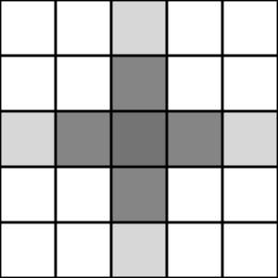
Methodology
Descriptive analysis of relationships between urban morphology, population and water scarcity?
Cellular automata model trained on existing data
Probabilistic predictive outcomes
Evaluation of the future of water scarcity by region
This Photo by Unknown Author is licensed under CC BY-SA

Slide 7
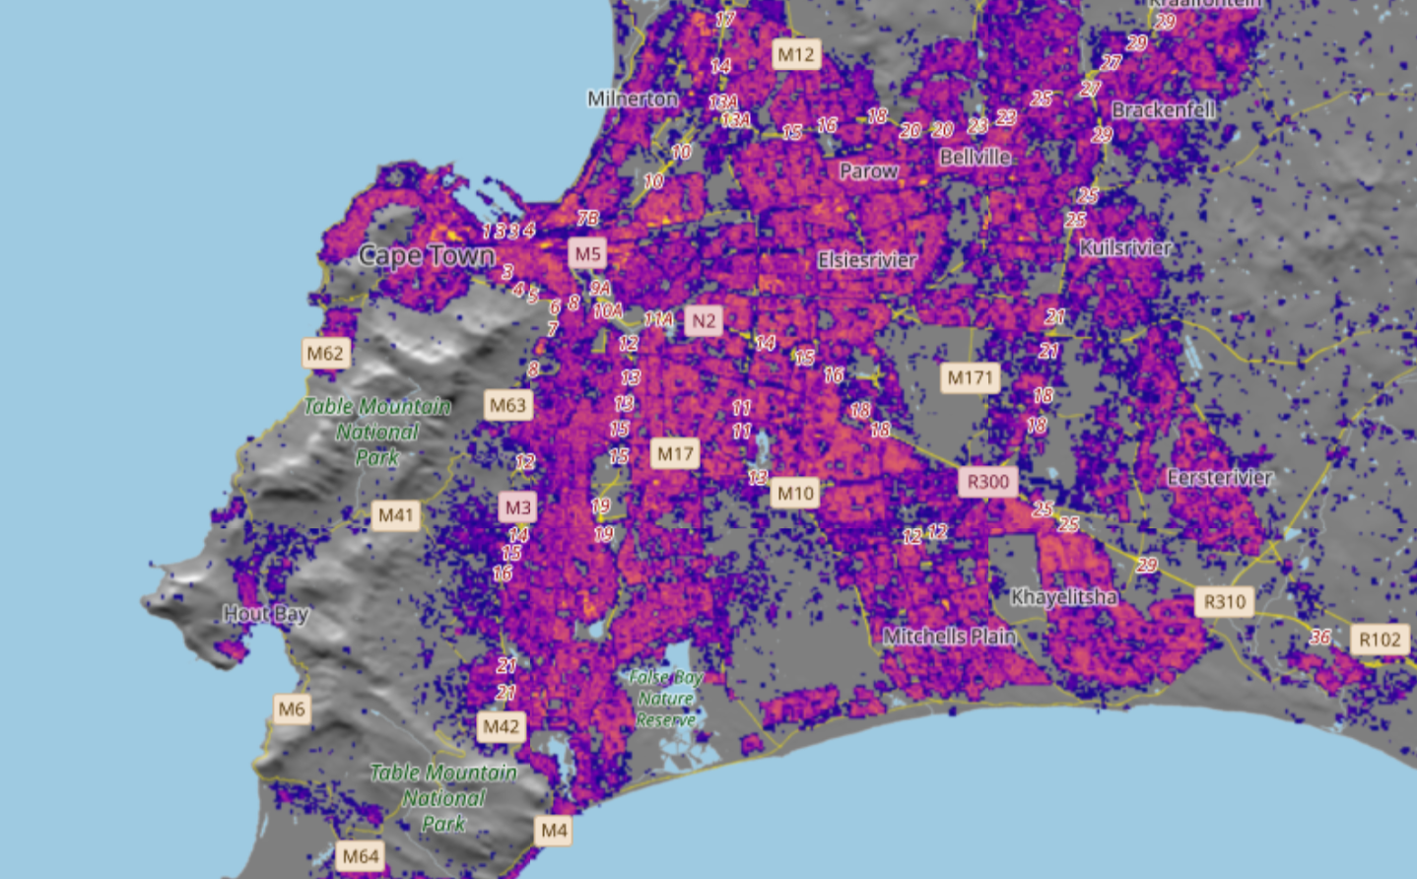
GSHL
01 : MSZ, open spaces, low vegetation surfaces NDVI <= 0.3 02 : MSZ, open spaces, medium vegetation surfaces 0.3 < NDVI <=0.5 03 : MSZ, open spaces, high vegetation surfaces NDVI > 0.5 04 : MSZ, open spaces, water surfaces LAND < 0.5 05 : MSZ, open spaces, road surfaces 11 : MSZ, built spaces, residential, building height <= 3m 12 : MSZ, built spaces, residential, 3m < building height <= 6m 13 : MSZ, built spaces, residential, 6m < building height <= 15m 14 : MSZ, built spaces, residential, 15m < building height <= 30m 15 : MSZ, built spaces, residential, building height > 30m 21 : MSZ, built spaces, non-residential, building height <= 3m 22 : MSZ, built spaces, non-residential, 3m < building height <= 6m 23 : MSZ, built spaces, non-residential, 6m < building height <= 15m 24 : MSZ, built spaces, non-residential, 15m < building height <= 30m 25 : MSZ, built spaces, non-residential, building height > 30m

Slide 8
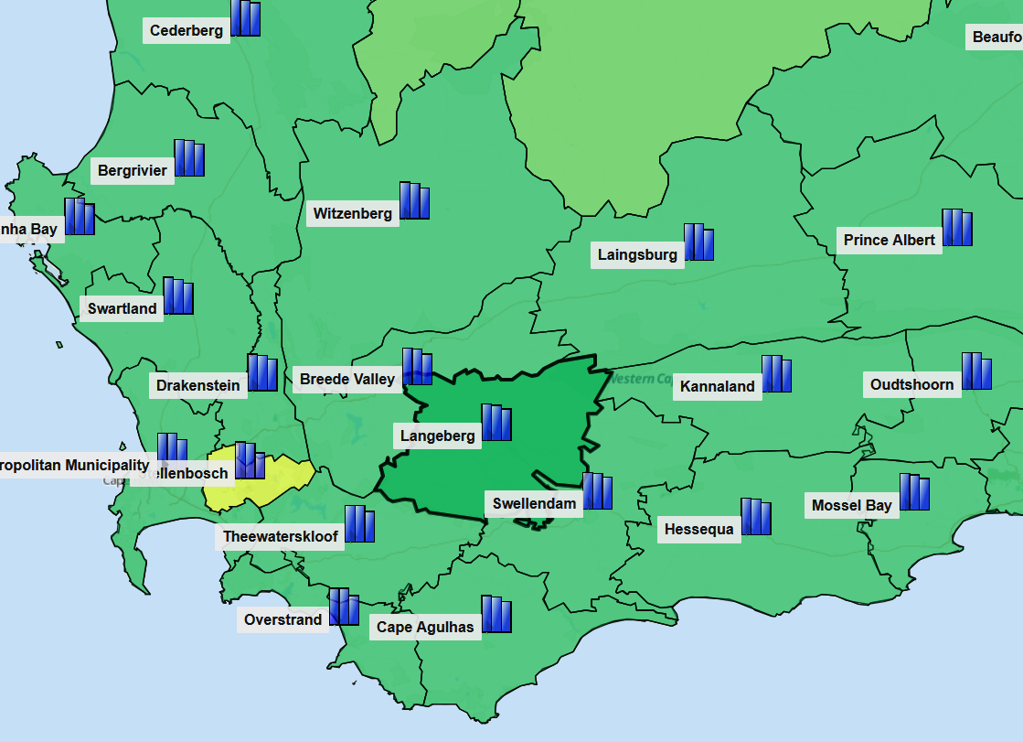
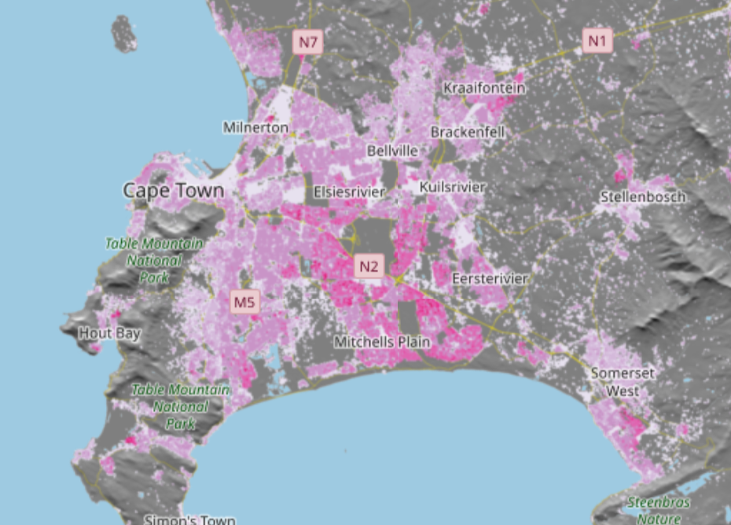
Water Scarcity and Population
Population density can be taken from the GSHL database as well
Water scarcity by municipality can be taken from SA department for Water and Sanitation
Likely that informed predictions on water scarcity at a higher resolution will be needed (define relationship between water scarcity, type of environment and population)

Slide 9
Processing
A single TIF file was 74Gb when rasterised…
Options include:
ArcGIS software for processing geospatial data (seems to be the academic go to resource) – already allows for superposition of rules
AWS credits – run toy models until a developed version exists, and then process results through external computation
Just build toy models using python/R and explore the potential limitations

Slide 10
Cellular Automata
Define governing rules/functions that are important to consider from the perspective of city growth (slope, distance to nearest city centre, access to major roads etc.) - work with the data
Cellular automata model trained on existing data, taking input functions (look at the development of one state over each time step)
Improvements: ABM multi-settlement interactions, Markov chains, Lattice Boltzmann model, fuzzy rules
Probabilistic predictive outcomes
Evaluation of the future of water scarcity by region

Slide 11
Further Direction
Model conflicting SDGs – wage equality and access to sanitised water informed cellular automata
Demonstrate the effectiveness of interventions/policy changes – hopefully show how a consideration from development in the fringe settlements can have a downstream positive impact in anticipation of expansion

